Slide 1
Operators in C
Unary Operator
Binary Operator
Ternary Operator

Slide 2
Unary Operator
unary minus (-)
unary plus (+)
decrement (- -)
increment (++)
NOT (!)
sizeof ()
Address of operator (&)

Slide 3
Binary Operator
Relational Operators
Arithmetic Operators
Logical Operators
Shift Operators
Conditional Operators
Bitwise Operators
Misc Operator
Assignment Operator

Slide 4
Arithmetic Operators
Operator | Description | Example
+ | Adds two operands. | A + B = 30
− | Subtracts second operand from the first. | A − B = -10
* | Multiplies both operands. | A * B = 200
/ | Divides numerator by de-numerator. | B / A = 2
% | Modulus Operator and remainder of after an integer division. | B % A = 0
++ | Increment operator increases the integer value by one. | A++ = 11
-- | Decrement operator decreases the integer value by one. | A-- = 9

Slide 5
Logical Operators
Operator | Description | Example
&& | Called Logical AND operator. If both the operands are non-zero, then the condition becomes true. | (A && B) is false.
|| | Called Logical OR Operator. If any of the two operands is non-zero, then the condition becomes true. | (A || B) is true.
! | Called Logical NOT Operator. It is used to reverse the logical state of its operand. If a condition is true, then Logical NOT operator will make it false. | !(A && B) is true.

Slide 6
Bitwise Operators
Operator | Description | Example
& | Binary AND Operator copies a bit to the result if it exists in both operands. | (A & B) = 12, i.e., 0000 1100
| | Binary OR Operator copies a bit if it exists in either operand. | (A | B) = 61, i.e., 0011 1101
^ | Binary XOR Operator copies the bit if it is set in one operand but not both. | (A ^ B) = 49, i.e., 0011 0001
~ | Binary Ones Complement Operator is unary and has the effect of 'flipping' bits. | (~A ) = -61, i.e,. 1100 0011 in 2's complement form.
<< | Binary Left Shift Operator. The left operands value is moved left by the number of bits specified by the right operand. | A << 2 = 240 i.e., 1111 0000
>> | Binary Right Shift Operator. The left operands value is moved right by the number of bits specified by the right operand. | A >> 2 = 15 i.e., 0000 1111

Slide 7
Assignment Operators
Operator | Description | Example
= | Simple assignment operator. Assigns values from right side operands to left side operand | C = A + B will assign the value of A + B to C
+= | Add AND assignment operator. It adds the right operand to the left operand and assign the result to the left operand. | C += A is equivalent to C = C + A
-= | Subtract AND assignment operator. It subtracts the right operand from the left operand and assigns the result to the left operand. | C -= A is equivalent to C = C – A
*= | Multiply AND assignment operator. It multiplies the right operand with the left operand and assigns the result to the left operand. | C *= A is equivalent to C = C * A
/= | Divide AND assignment operator. It divides the left operand with the right operand and assigns the result to the left operand. | C /= A is equivalent to C = C / A

Slide 8
%= | Modulus AND assignment operator. It takes modulus using two operands and assigns the result to the left operand. | C %= A is equivalent to C = C % A
<<= | Left shift AND assignment operator. | C <<= 2 is same as C = C << 2
>>= | Right shift AND assignment operator. | C >>= 2 is same as C = C >> 2
&= | Bitwise AND assignment operator. | C &= 2 is same as C = C & 2
^= | Bitwise exclusive OR and assignment operator. | C ^= 2 is same as C = C ^ 2
|= | Bitwise inclusive OR and assignment operator. | C |= 2 is same as C = C | 2

Slide 9
Misc Operators
Operator | Description | Example
sizeof() | Returns the size of a variable. | sizeof(a), where a is integer, will return 4.
& | Returns the address of a variable. | &a; returns the actual address of the variable.
* | Pointer to a variable. | *a;
? : | Conditional Expression. | If Condition is true ? then value X : otherwise value Y

Slide 10
Relational Operators
Operator | Description | Example
== | Checks if the values of two operands are equal or not. If yes, then the condition becomes true. | (A == B) is not true.
!= | Checks if the values of two operands are equal or not. If the values are not equal, then the condition becomes true. | (A != B) is true.
> | Checks if the value of left operand is greater than the value of right operand. If yes, then the condition becomes true. | (A > B) is not true.
< | Checks if the value of left operand is less than the value of right operand. If yes, then the condition becomes true. | (A < B) is true.
>= | Checks if the value of left operand is greater than or equal to the value of right operand. If yes, then the condition becomes true. | (A >= B) is not true.
<= | Checks if the value of left operand is less than or equal to the value of right operand. If yes, then the condition becomes true. | (A <= B) is true.

Slide 11
Ternary Operator
Using this operator would require a total of three operands. For instance, we can use the ?: in place of the if-else conditions.
result = binaryCondition ? valueReturnedIfTrue : valueReturnedIfFalse;
C=A>B?A:B;

Slide 12
Backslash Character Constants
Meaning of Character | Backslash Character
Backspace | \b
New line | \n
Form feed | \f
Horizontal tab | \t
Carriage return | \r
Single quote | \’
Double quote | \”
Vertical tab | \v
Backslash | \\
Question mark | \?
Alert or bell | \a
Hexadecimal constant (Here, N – hex.dcml cnst) | \XN
Octal constant (Here, N is an octal constant) | \N

Slide 13
Associativity of Operators in C
When precedence of two operators are same then associativity of operator is considered for evaluation
A=20
B=10
S=a+b/(a-b)
20+10/(20-10)

Slide 14
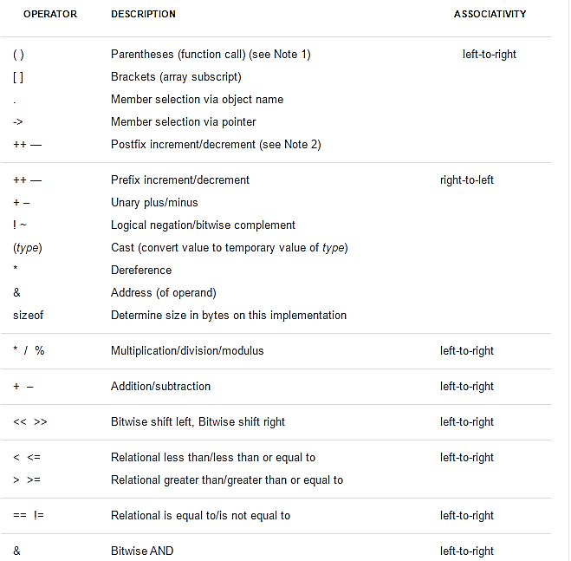

Slide 15
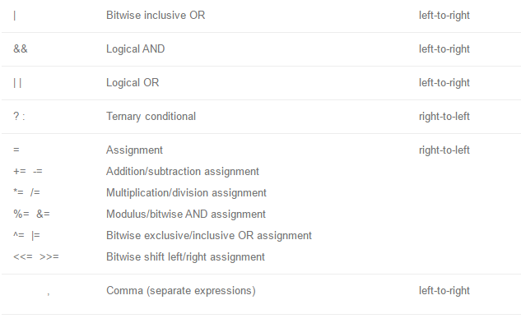

Slide 16
Example
#include<stdio.h> main() { int a, b,c; a = 4; c =++a+ a++; printf ( "c = %d", c) ; printf ( "a = %d", a) ; }

Slide 17
Output
c = 10 a = 6

Slide 18
Example
#include<stdio.h> main() { int a, b,c; a = 4; c = ++a + ++a; printf ( "c = %d", c) ; printf ( "a = %d", a) ; }

Slide 19
Output
c = 12 a = 6

Slide 20
Example
#include<stdio.h> main() { int a, b,c; a = 4; c = a++ + ++a; printf ( "c = %d", c) ; printf ( "a = %d", a) ; }

Slide 21
Output
c = 10 a = 6

